Slide 1

CSS3:
Borders

Slide 2
Module Overview
Resizable
Rounded corners
Shadowing

Slide 3
When the complaint box isn’t big enough
Resizable

Slide 4
Resize
.box {
resize: both; none|horizontal|vertical overflow: auto; !visible
max-­‐width: 600px; max-­‐height: 400px; cursor: move;
}

Slide 5
Smoothing out the rough edges
Rounded Corners

Slide 6
Rounded Corners
.softCorners {
border-­‐radius: 5%;
}
.roundUp { border-­‐radius:
}
.sameAsRoundUp {
2em;
border-­‐top-­‐left-­‐radius:2em; border-­‐top-­‐right-­‐radius:2em; border-­‐bottom-­‐right-­‐radius:2em; border-­‐bottom-­‐left-­‐radius:2em;
}

Slide 7
CSS3 Demos Web Site
DEMO

Slide 8
Providing depth and perspective to what we display
Shadowing

Slide 9




Box Shadows
.downRightShady {
box-­‐shadow: 4px 4px #00000;
}
.upAndLeftShady {
box-­‐shadow: -­‐4px -­‐4px #00000;
}
.shadeWithFade { box-­‐shadow:
}
.glowing {
4px 4px 10px #00000;
box-­‐shadow: 0 0 10px
#44FF44;
}

Slide 10






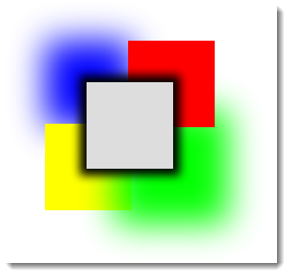
Complex Box Shadows
box-­‐shadow:
0 0 1em #000000, /* all sides */ 3em -­‐3em #FF0000, /* upper right */
3em 3em 4em #00FF00, /* lower right */
-­‐3em 3em #FFFF00, /* lower left */
-­‐3em -­‐3em 4em #0000FF; /* upper left */

Slide 11
CSS3 Demos Web Site
DEMO

Slide 12
Summary
Allow users to resize content
Smooth corners of choice
Provide shadows in any direction, with color of choice

